Slide 1
Leveraging ADL Archetypes by Transforming them to AML Archetypes
MS Thesis Presentation
By
Deepak Sharma
Master of Science
Biomedical Informatics & Computational Biology
University of Minnesota, Rochester
August 07, 2015

Slide 2
About Me
1st - MS Computer Science, India (1996)
2nd - MS Student in BICB (2015)
- ‘Biomedical/Healthcare Informatics’ focus
Software Professional – 19 years
12 Years at Mayo Clinic
Biomedical & Clinical Informatics Applications
Expertise in Domains:
Healthcare, Supply Chain, Finance, Middleware, Networks, Education

Slide 3



Advisers
Dr. Christopher G. Chute, MD, Dr. P.H.
Bloomberg Distinguished Professor of Health Informatics,
Professor of Medicine, Public Health, and Nursing,
Chief Health Information Research Officer,
Johns Hopkins Medicine Professor,
Johns Hopkins, Baltimore, Maryland.
Dr. Claudia Neuhauser, PhD.
Director of Informatics Institute,
Interim Director, Minnesota Supercomputing Institute,
Office of the Vice President for Research,
Director of Graduate Studies, Biomedical Informatics & Computational Biology
University Of Minnesota, Minneapolis, Minnesota.
Dr. Guoqian Jiang, MD, PhD.
Associate Professor of Biomedical Informatics,
Associate Consultant in Department of Health Sciences Research,
Division of Biomedical Statistics & Informatics,
Mayo Clinic College of Medicine,
Rochester, Minnesota.

Slide 4

Mentor
Harold R. Solbrig, MS
Technical Specialist II,
Division of Biomedical Statistics & Informatics,
Mayo Clinic,
Rochester, Minnesota.

Slide 5
Agenda
Background
Problem Statement
Transformation Mappings
Implementation

Slide 6
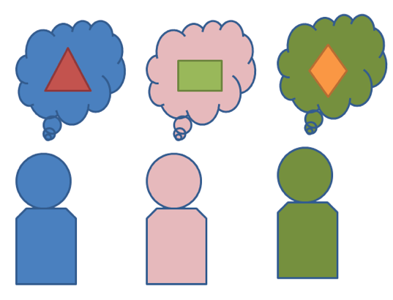
Background
“Make Interoperability Better”
Digital information Exchange
How to be “On The Same Page”?
Data
What it is?
Semantics
What it means?
Meaning is more important

Slide 7
Background
Standards – Share Model, Metadata
XML Schemas, Properties, Custom Maps
Proprietary, custom tools,IDEs (not shared freely)
Binding to Standard Terminologies
SNOMED-CT, ICD 10, LOINC,….
IsoSemantic Models
instances intend to mean the same thing
Additional Steps, Transforms for local use, in-sync ?

Slide 8
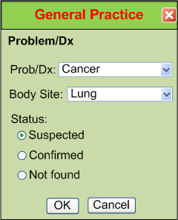
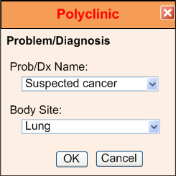
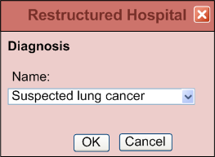
IsoSemantic Models
e.g. “Suspected Lung Cancer”
Courtesy: Dr. Stanley M. Huff (Intermountain HealthCare), and Dr. Linda Bird (IHTSDO)

Slide 9
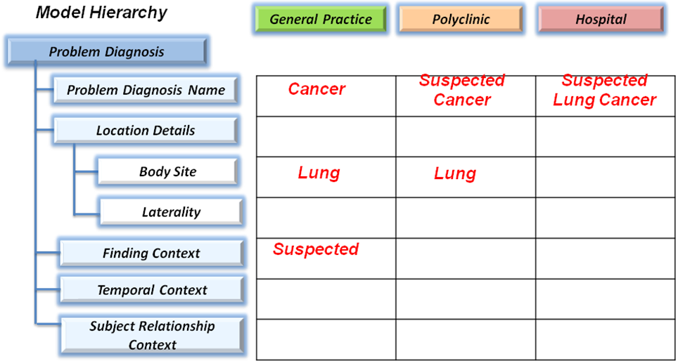
IsoSemantic Models
e.g. “Suspected Lung Cancer”
Courtesy: Dr. Stanley M. Huff (Intermountain HealthCare), and Dr. Linda Bird (IHTSDO)

Slide 10
Archetypes
Archetypes – Constraint Based Models
Constraint or Bottom-up Modeling
Start with a general model
The most abstract level of exchange
Specialize by
Cardinality
Values and value ranges
Optional/Mandatory/Prohibited
Enumeration subsets

Slide 11
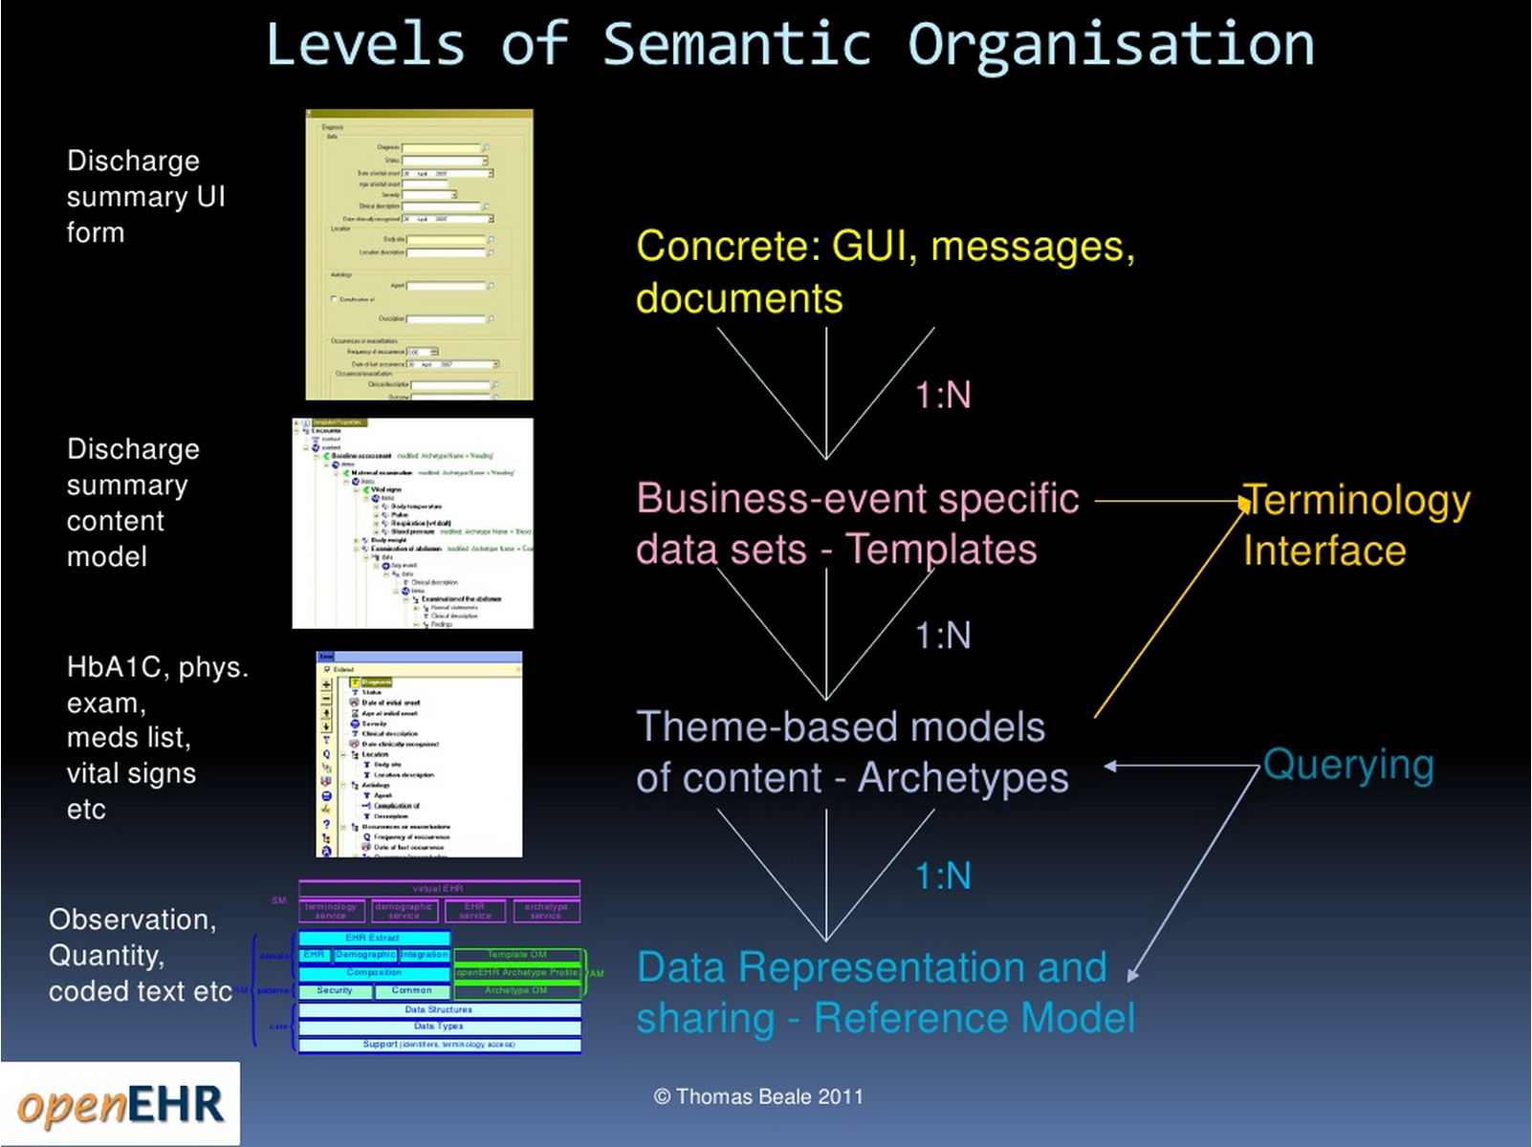
Archetypes

Slide 12
Archetypes
Constraints on shared (reference) model
Archetype Example:
Definition of “Abnormal A1C Test” Archetype:
Model Class:
LaboratoryTest {1}
measuredValue {1..*}
Constraints:
{x| x in {measuredValues},
x > SomeThresholdValueforA1C}

Slide 13
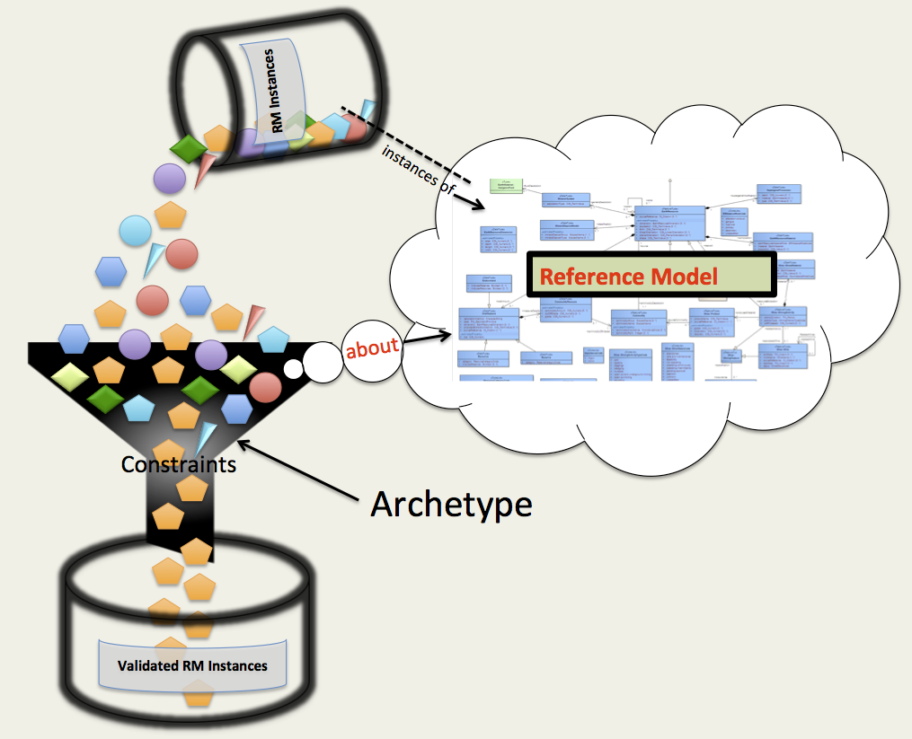
Archetypes

Slide 14
Archetypes
Archetypes:
Strive to improve interoperability
Shared Reference Model
Shared Constraints
Binding to Standard Terminologies
Provide Application Development Flexibility
Archetypes are treated as resource and separated from RM implementation

Slide 15
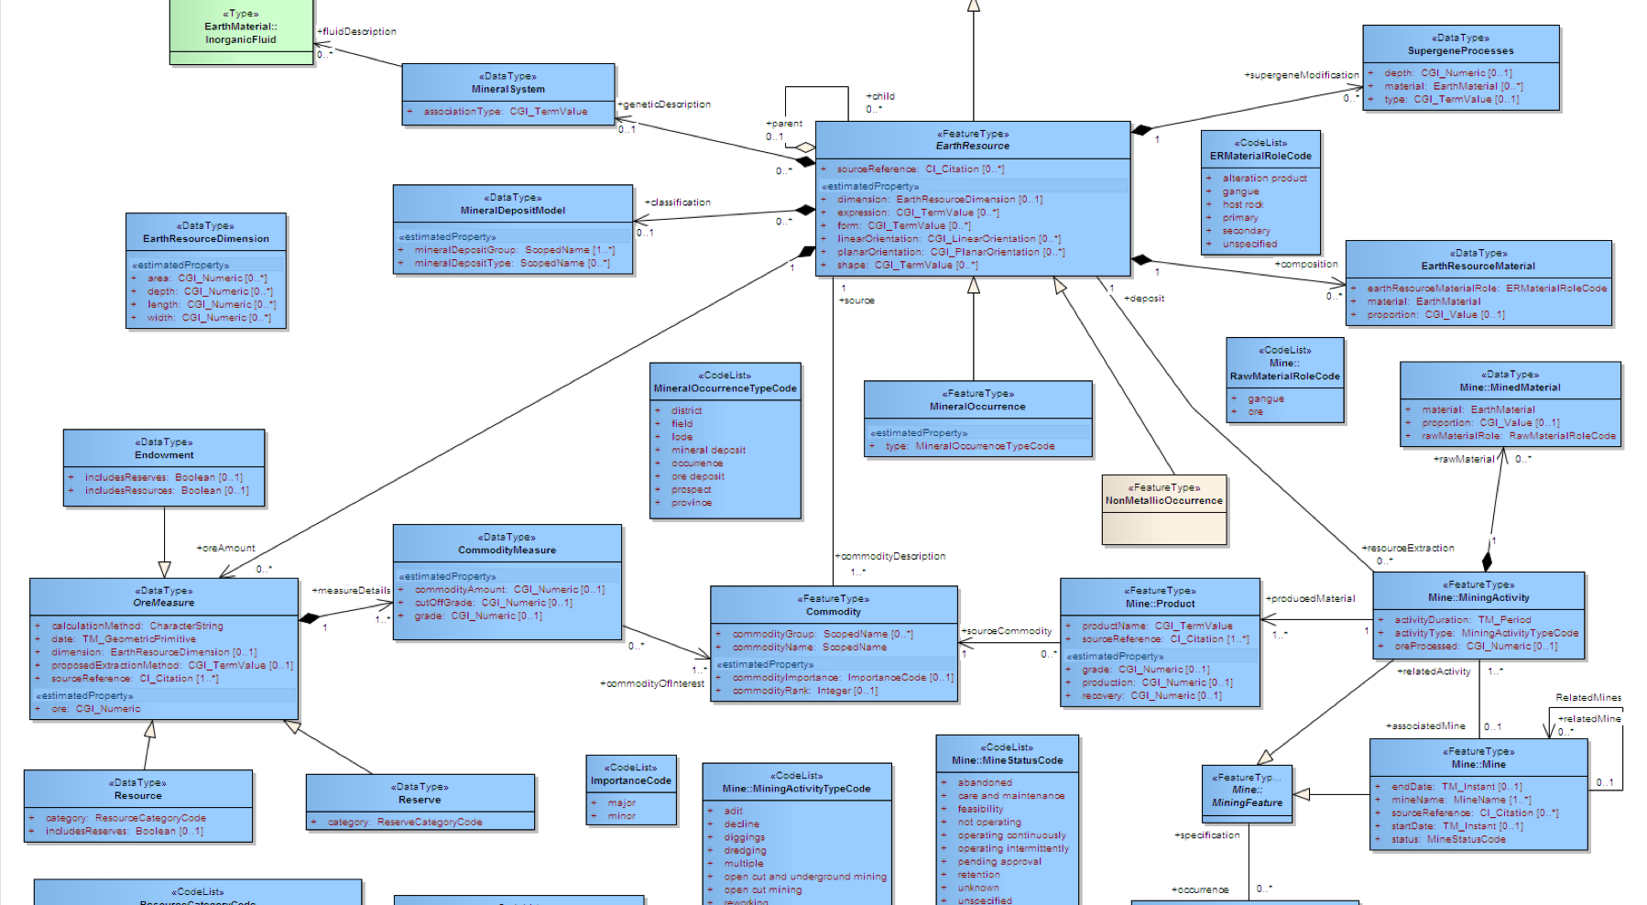
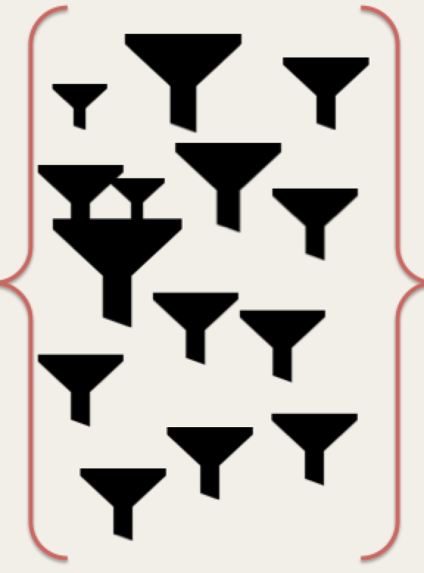
Application Development Flexibility
Reference Model
A1C
Application
Archetype Library

Slide 16
Authoring Archetypes
Authoring Archetypes:
OpenEHR ADL
“Archetype Definition Language”
Object Management Group AML
“Archetype Modeling Language”
HL7 DCM, IHC CEM,…

Slide 17
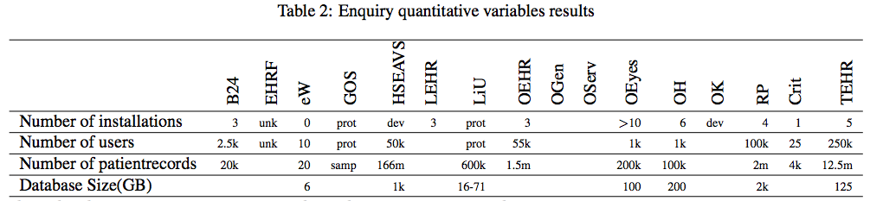

Archetype Definition Language (ADL)
ADL is popular ! (at least outside US)
Australia
Brazil
The Netherlands
Norway
Portugal
Russia
Slovenia
Sweden
UK
2013
http://www.openehr.org/who_is_using_openehr/healthcare_providers_and_authorities
http://www.researchgate.net/publication/261351942_Survey_of_openEHR_storage_implementations

Slide 18
Archetype Definition Language (ADL)
Authoring Archetypes with:
OpenEHR ADL
Most traction – Rich archetypes
Modeling Tools - ADL Workbench
ODIN – Object Data Instance Notation Format
ADL Object Model (AOM)

Slide 19

Clinical Information Modeling Initiative
Since 2011
http://www.opencimi.org/
Mission Statement
“Improve the interoperability of healthcare systems through shared implementable clinical information models”
(A Single Curated Collection)

Slide 20
CIMI – Strategic Goal
“Be able to share data, applications, reports, alerts, protocols, and decision support modules with anyone in the world”
Source: http://www.opencimi.org/

Slide 21
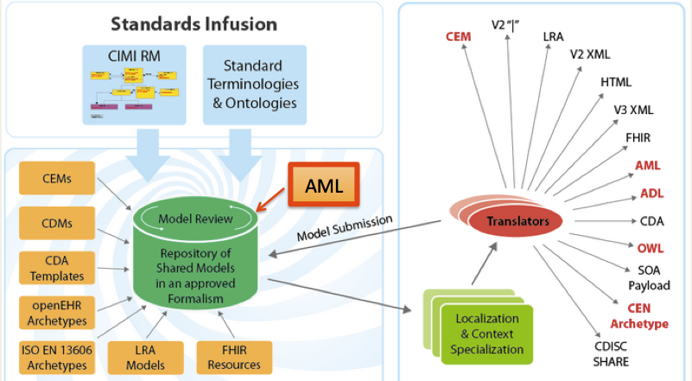
Clinical Information Modeling Initiative
CIMI Shared Model Repository

Slide 22
Archetype Modeling Language (AML)
Authoring Archetypes with:
OMG AML - Brand New (May 2015)
By Clinical Information Modeling Initiative (CIMI)
UML Format
Inspired, guided by ADL, AOM
Set of 3 UML Profiles

Slide 23
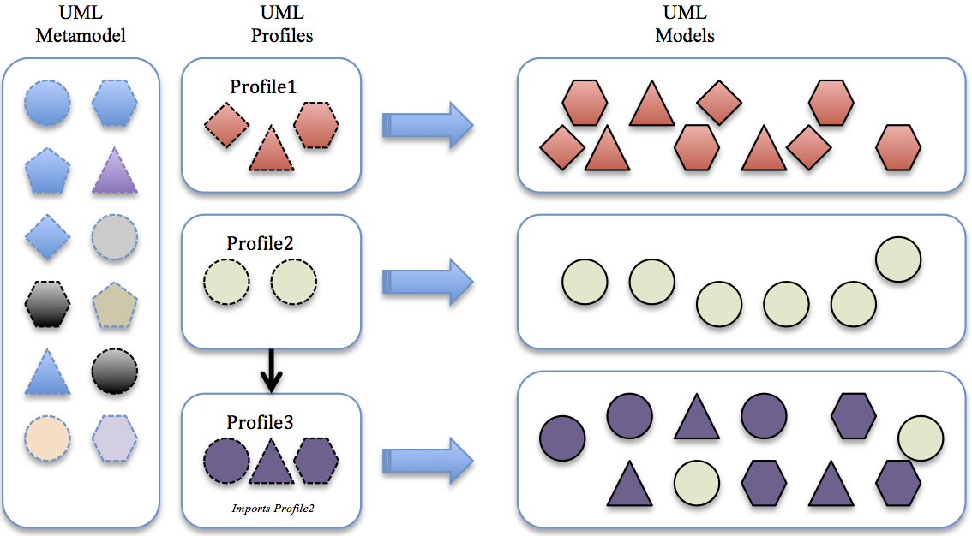
About UML Profiles
UML Profiles

Slide 24
AML Benefits
UML is OMG Standard
UML - Familiar to Modelers
Existing UML Tools
RM need not be converted
Easy gateway to MDA

Slide 25
Agenda
Background
Problem Statement
Transformation Mappings
Implementation

Slide 26
Quick Comparison
ADL | AML
OpenEHR, ISO 13606-2 Standard (2011) | New OMG Standard (2015)
Rich set of archetypes | Converted/Transformed archetypes
Open-source Modeling Tools | Tooling in progress
Reference Models in Basic Meta Model (BMM) proprietary format | Reference Model in UML
Archetypes in ODIN, cADL proprietary formats | Archetype in UML

Slide 27
Pros & Cons
ADL | AML
OpenEHR, ISO 13606-2 Standard (2011) | New OMG Standard (2015)
Rich set of archetypes | Converted/Transformed archetypes
Open-source Modeling Tools | Tooling in progress
Reference Models in Basic Meta Model (BMM) proprietary format | Reference Model in UML
Archetypes in ODIN, cADL proprietary formats | Archetype in UML

Slide 28
Problems with ADL
ADL’s proprietary ODIN, BMM, cADL
RM needed to converted to BMM
No easy gateway to Model-Driven Architecture (MDA)
Tied to OpenEHR Tooling
RM ties to OpenEHR RM – Upcoming tooling (not Eiffel)

Slide 29
Problems with AML
New OMG Standard
No native archetypes
Lack of tooling
→ Manual creation of AML archetypes
Tedious
Error-prone
Confusing even to expert modeler

Slide 30
Problem Statement
How to?
Benefit from AML’s UML format
Leverage existing set of rich ADL archetypes
Avoid manual process:
re-creating ADL archetypes as AML archetypes
Make valid AML archetypes

Slide 31
Agenda
Background
Problem Statement
Transformation Mappings
Implementation

Slide 32
Goals
Create Tools to:
Transform ADL archetypes to AML
New ones Programmatically, GUI
Conform to AML Specifications
Generic and Open-source

Slide 33
Approach
Understanding of ADL and AML
Identify lossless mappings
Implement a generic solution

Slide 34
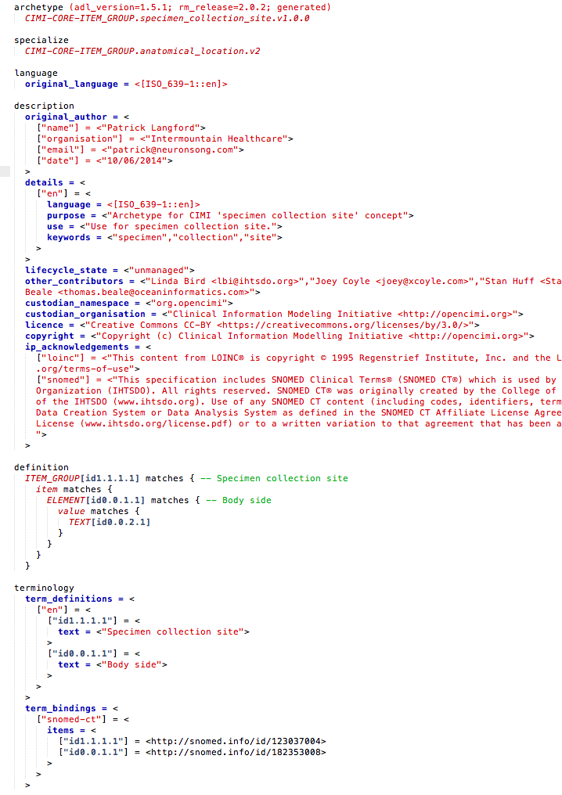
ADL

Slide 35
ADL
Archetype Metadata Section
Constraints/Definition Section
Terms & Terminology Binding Section

Slide 36
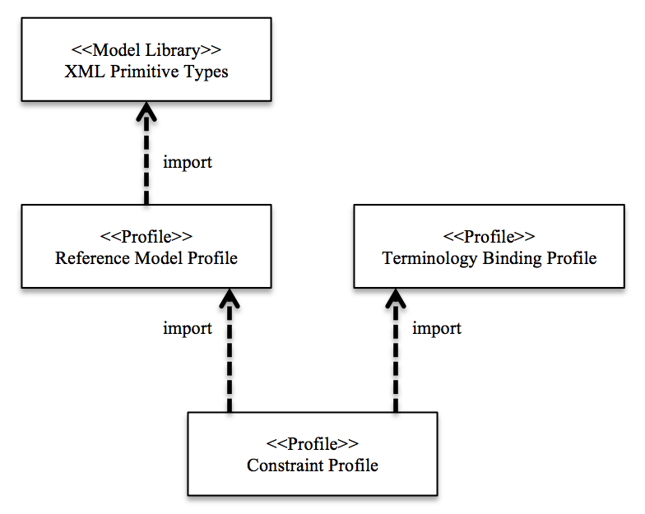
3 Profiles of AML

Slide 37
The Mappings
Archetype Metadata Section
Constraints/Definition Section
Terms & Terminology Binding Section

Slide 38
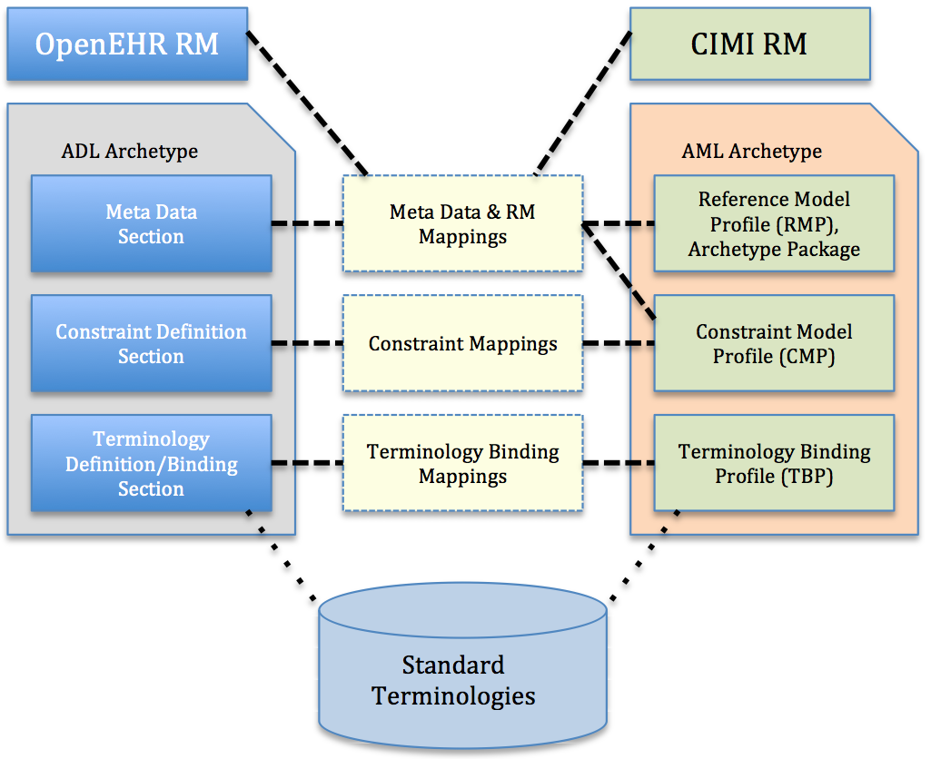
ADL → AML Mappings
Traceability Matrix

Slide 39
The Mappings
Reference Model Mappings
Archetype Identification Mappings
Constraint Mappings
Terminology Binding Mappings

Slide 40
Reference Model Mappings
RM Characteristics:
Publisher, Namespace
RM Class – ‘about’ this
Data Types

Slide 41
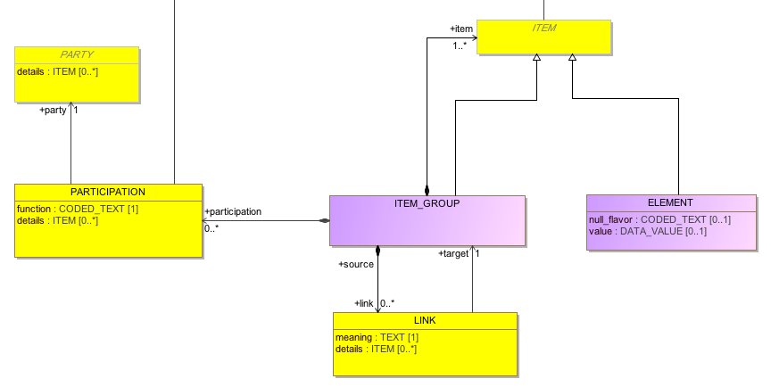
CIMI Reference Model
ITEM_GROUP
ITEM
ELEMENT
ITEM
ITEM_GROUP
ITEM
ELEMENT
ITEM
ELEMENT
ELEMENT
miniCIMI Reference Model

Slide 42
ADL
Archetype Metadata Section
Constraints/Definition Section
Terms & Terminology Binding Section

Slide 43
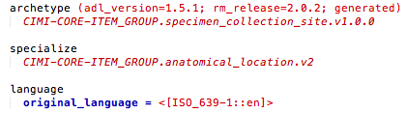
ADL

Slide 44
ADL
publisher
RM Class
RM Release Version

Slide 45
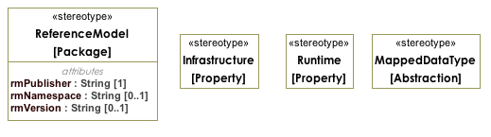
AML Reference Model Profile

Slide 46
ADL → AML
publisher
RM Class
RM Release Version

Slide 47
Reference Model Mappings
ADL | AML Profile
Publisher (rm_publisher) | <<ReferenceModel>>::rmPublisher
RM Class (rm_class) | Root/Defining Class of Archetype. Corresponds to the the name of the <<ReferenceModel>> Class specialized by this archetype.
RM Release Version (rm_release) | <<ReferenceModel>>::rmVersion

Slide 48
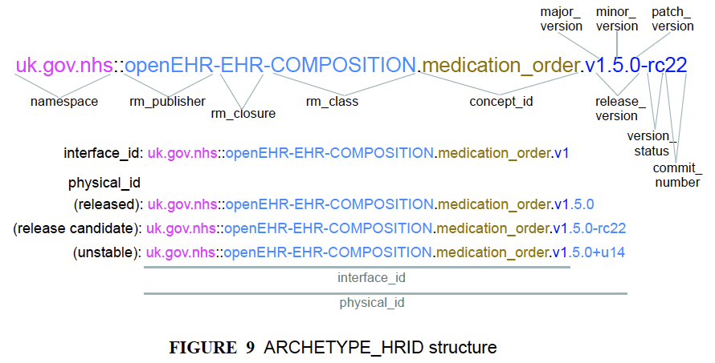
Archetype Identification Mappings

Slide 49
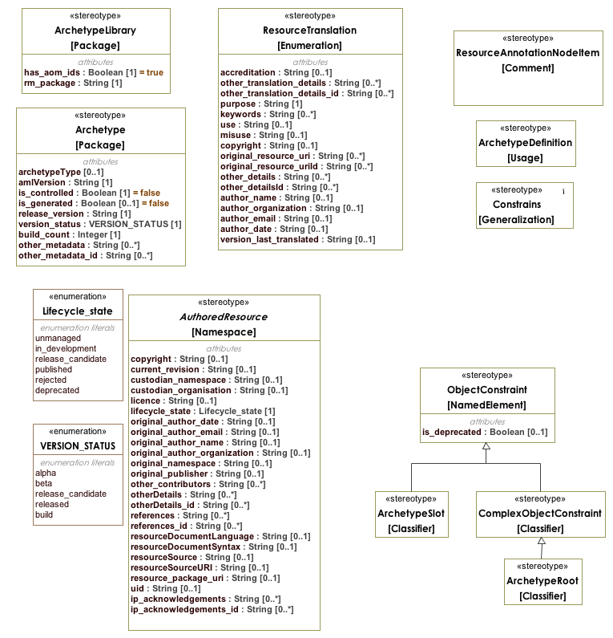
Archetype Identification Mappings
AML Constraints Model Profile (CMP)

Slide 50
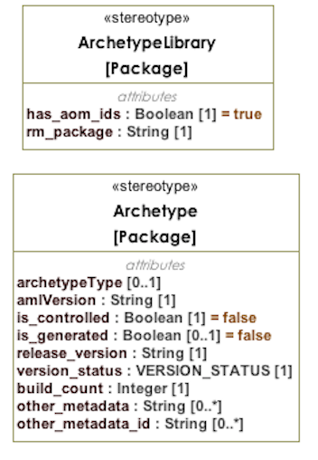
Archetype Identification Mappings
AML Constraints Model Profile (CMP)

Slide 51
Archetype Identification Mappings
ADL | AML CMP
Namespace | <<Archetype>> Package URI
Closure (rm_closure) | <<ArchetypeLibrary>>::rm_package
Archetype Release Version | <<Archetype>>::release_version
Archetype Version Status | <<Archetype>>::version_status
Archetype Build Count | <<Archetype>>::build_count
Concept Id | <<Archetype>> Package Name

Slide 52
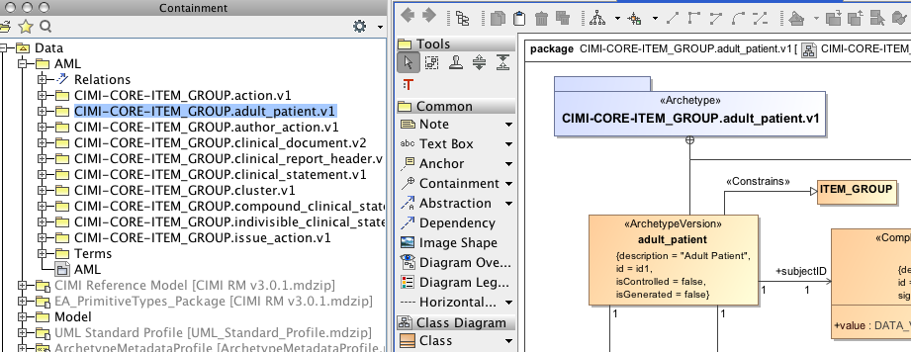
Archetype Identification Mappings
Archetype ‘adult_patient’ – colorectal cancer patient
Subject ID,
Site of procedure (enumerated values – 2 permissible values),
Age (> 17)

Slide 53
Constraints Mappings
Constraining…
RM Class, Parent Archetype
Reusing other archetypes
Matching archetype patterns

Slide 54
Constraints Mappings
Archetype Library imports exactly one RM
Archetypes constraint same RM
Constrain – types, cardinality, possible values
Archetype ‘reuse’ – <<ArchetypeRoot>>
Constraint Pattern – <<ArchetypeSlot>>

Slide 55
Constraints Mappings
Archetype Specialization
Simple UML inheritance
UML Property Constraints Semantics
Subset - interval, range, permissible values
Redefine - single value

Slide 56
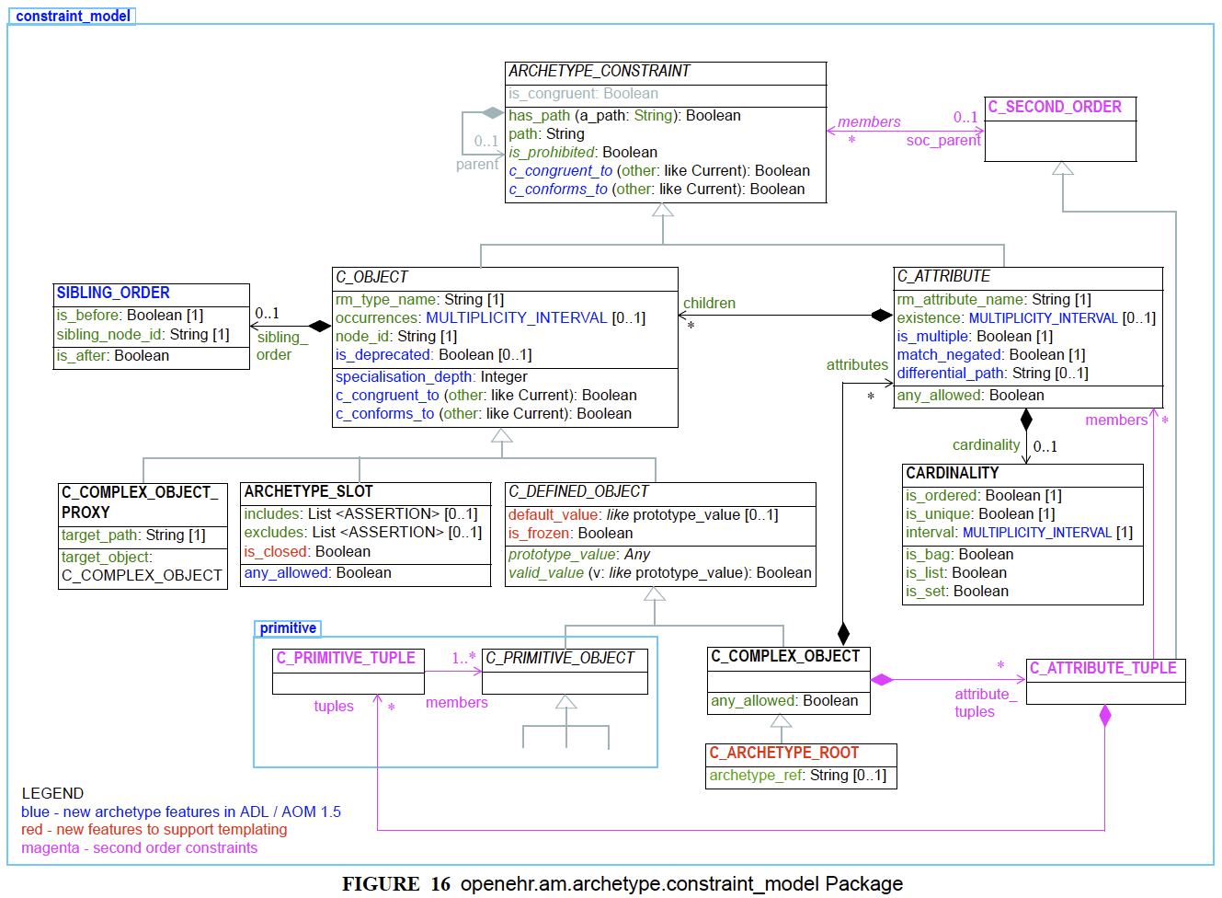
Constraints Mappings

Slide 57
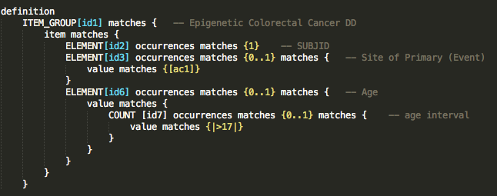
Constraints Mappings

Slide 58
Constraints Mappings
AML Constraints Model Profile (CMP)

Slide 59
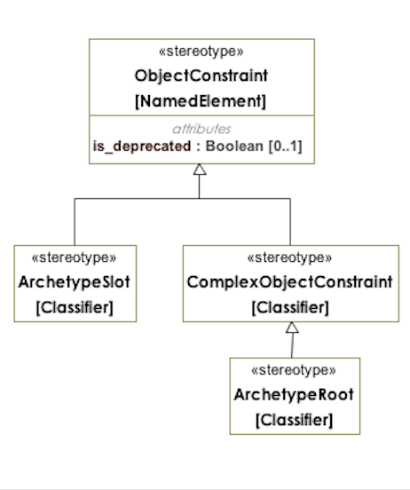
Constraints Mappings
AML Constraints Model Profile (CMP)

Slide 60
Constraints Mappings
ADL | AML CMP
C_COMPLEX_OBJECT | <<ComplexObjectConstraint>>
C_ARCHETYPE_ROOT | <<ArchteypeRoot>>
C_ARCHETYPE_SLOT | <<ArchetypeSlot>>
AUTHORED_RESOURCE, RESOURCE_DESCRIPTION | <<AuthoredResource>>
C_OBJECT/rm_type_name | ‘Constrains’ RM Classifier
ARCHETYPE_CONSTRAINT/parent | ‘Constrains’ Parent Archetype
C_ATTRIBUTE/rm_attr_name | RM Attribute that is being ‘constrained’
C_ATTRIBUTE/properties | Owned properties of ComplexObjectConstraint
RESOURCE_ANNOTATIONS | <<ResourceAnnotationNodeItem>>
TRANSLATION_DETAILS | <<ResourceTranslation>>

Slide 61
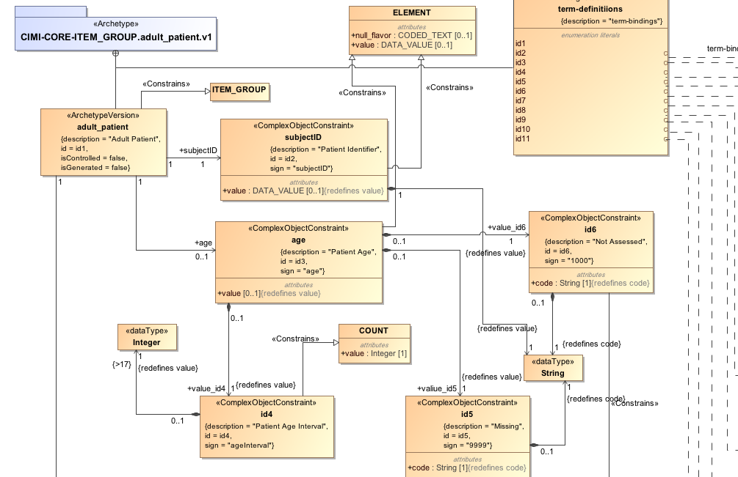
Constraints Mappings
Archetype ‘adult_patient’ – colorectal cancer patient
Subject ID,
Site of procedure (enumerated values – 2 permissible values),
Age (> 17)

Slide 62
Terminology Binding Mappings
Binds model elements to their meaning
Local (within archetype)
External (Standard Terminologies)

Slide 63
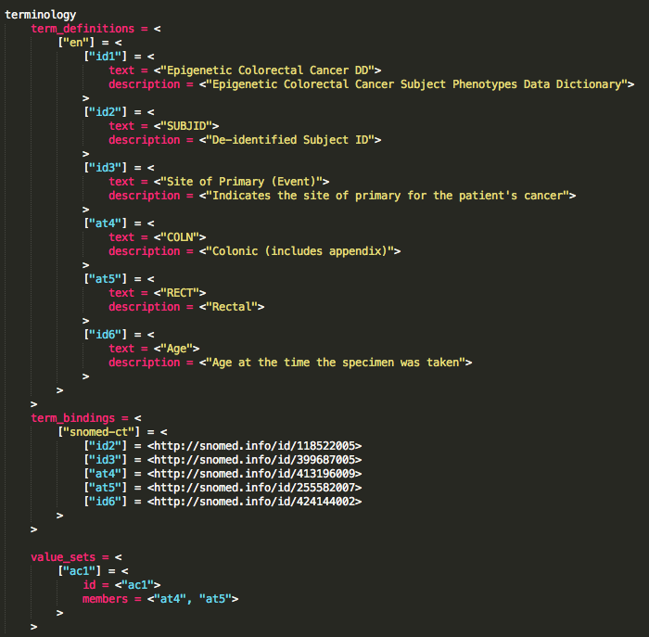
Terminology Binding Mappings
Archetype ‘adult_patient’ – colorectal cancer patient
Subject ID,
Site of procedure (enumerated values – 2 permissible values),
Age (> 17)

Slide 64
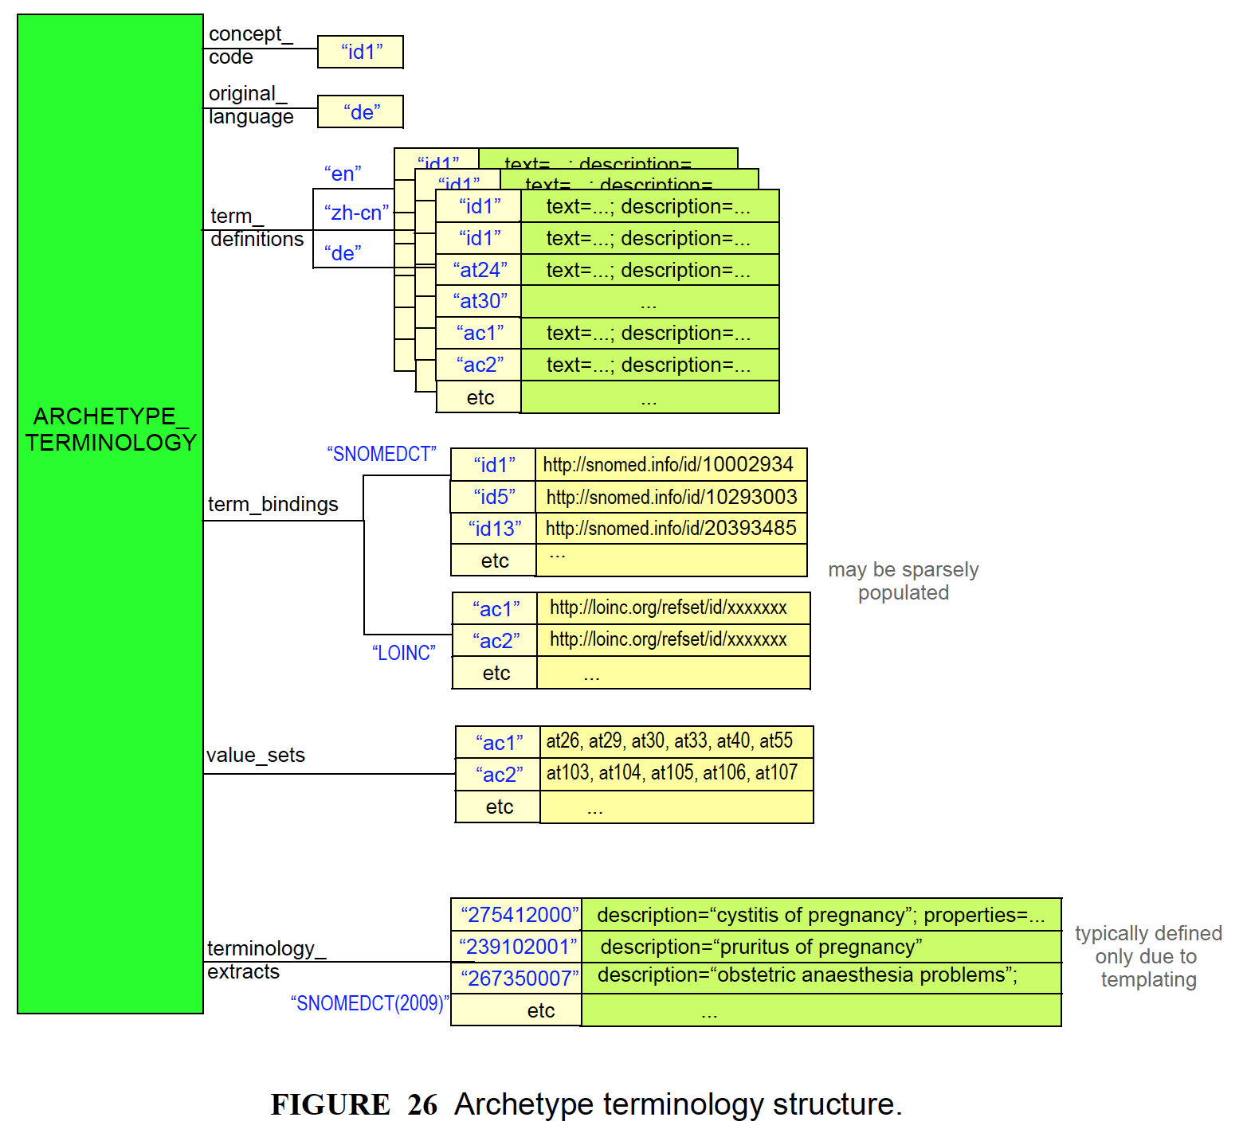
Terminology Binding Mappings

Slide 65
Terminology Binding Profile
Guided by -
ISO 11179 – Metadata Repository (3rd Ed.)
Has built-in support for-
OMG Common Terminology Services (CTS2)
to bind using terminology resources like:
Code Systems
Value Sets and Permissible Values

Slide 66
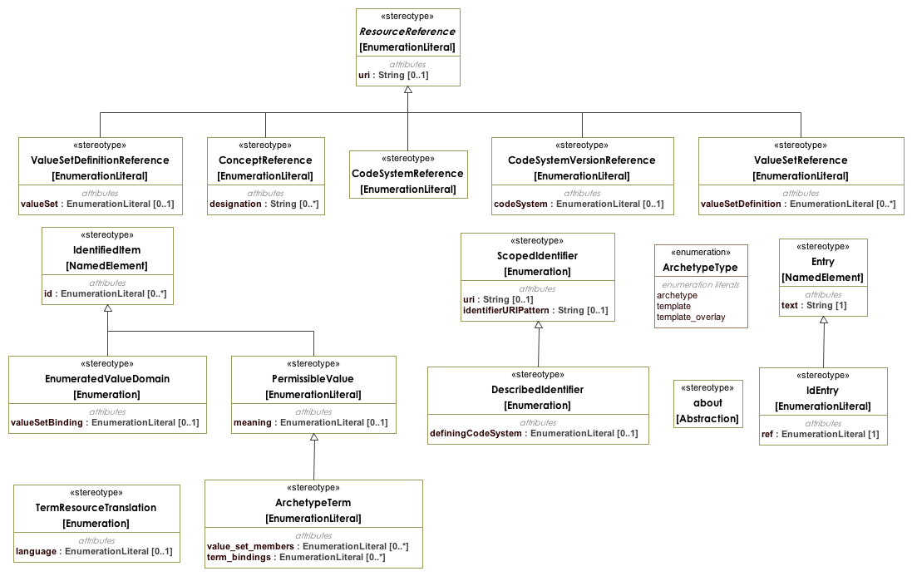
Terminology Binding Mappings

Slide 67
Terminology Binding Mappings
ADL | AML Profile
ADL Identifiers start with “id” | Constraint Class
ADL Identifiers start with “ac” | Enumeration - Value Sets (collection of permissible values)
ADL Identifiers start with “at” | Enumeration Literals – Permissible values
Term Definitions | Resource Translation, Entry IdEntry
Term Bindings | Enumeration Literal has <<ConceptReference>> to terminology concept

Slide 68
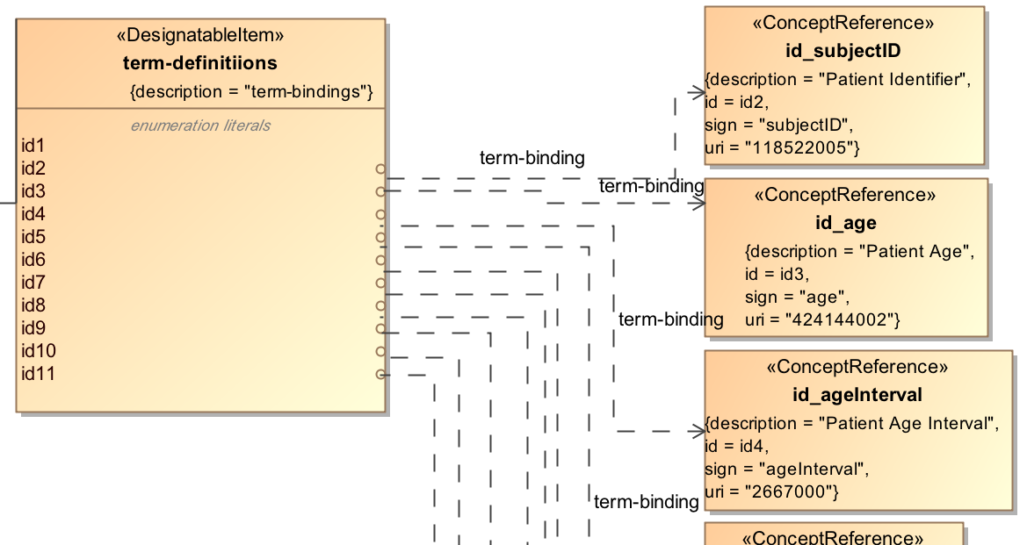
Terminology Binding Mappings

Slide 69
Agenda
Background
Problem Statement
Transformation Mappings
Implementation

Slide 70
ADL → AML Transform
Traceability Matrix
AML
UML
Export to a target format
(MDZIP), more coming…
ADL Objects
AML Objects
ADL2AML
Converter
ADL Parser
MD Open API
ADL

Slide 71
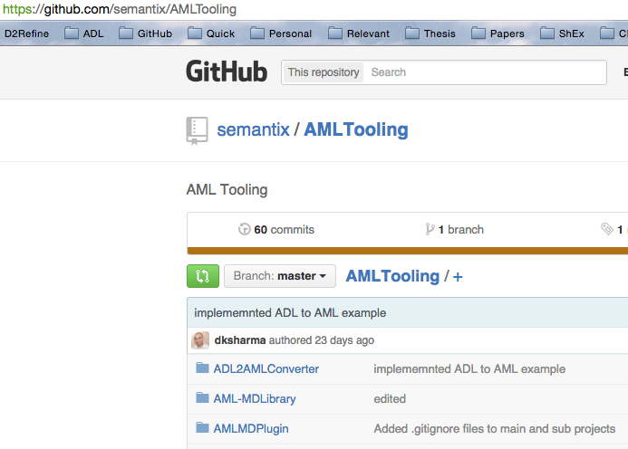
AML Tooling

Slide 72
AML Tooling
Project Location:
https://github.com/semantix/AMLTooling
Sub-projects:
ADL2AMLConverter – The Converter
AML MD Library – AML Wrapper on MD Open API
AML MD Plugin – Menu Plug-in to MagicDraw IDE

Slide 73
Auxiliary Tasks Completed
Model 2 Text Transforms:
Completed IBM RSA Business Intelligence Report Tool (BIRT) Template to dynamically generate specifications
Completed Apache Velocity Template –
IBM RSA → MagicDraw
Prototyping & Testing MagicDraw OpenAPIs
AML Specifications Management Workflow
EA -> RSA -> MD, Release

Slide 74
Limitations & Mitigations
Only core maps - Arch ID, CMP implemented
Programmatic validation planned
Need to move to Open-source ECore Impl.
Current serialization in MDZIPs, but can be exported to XMI

Slide 75
Next Steps
Align work with OpenEHR Java and XML Tooling upgrades
Exploiting MDA for checking archetype creation prerequisites and validation
Shape Expressions (ShEx)

Slide 76
Agenda
Background
Problem Statement
Transformation Mappings
Implementation

Slide 77
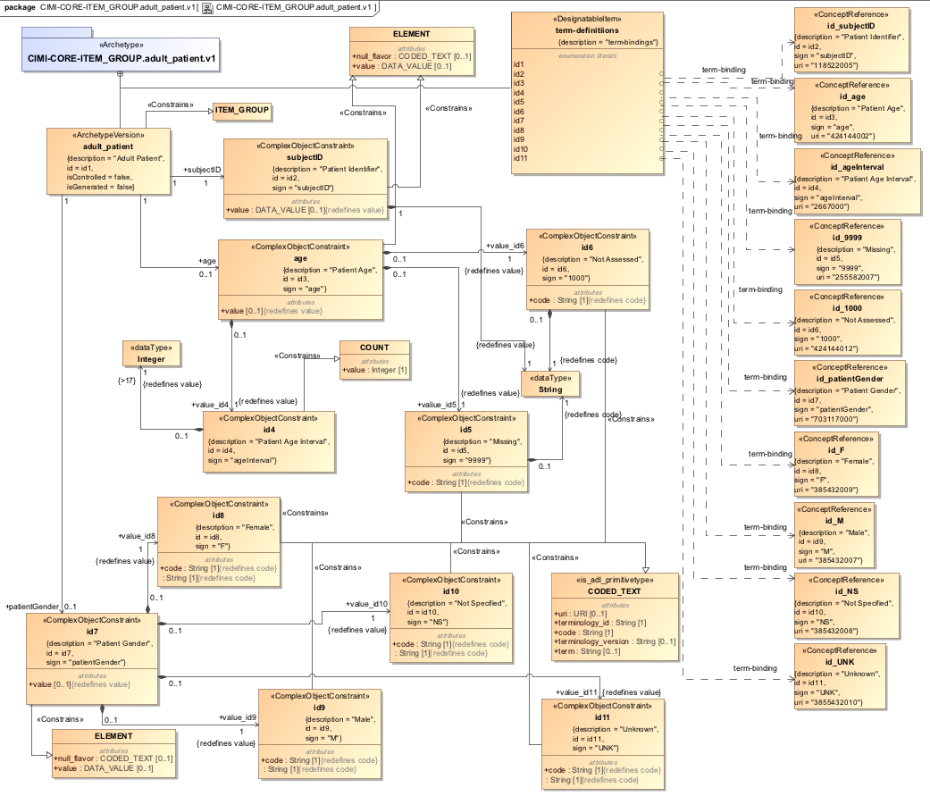
Archetype ‘adult_patient’ – colorectal cancer patient
Subject ID,
Site of procedure (enumerated values – 2 permissible values),
Age (> 17)

Slide 78
Conclusion
Mappings bridge the ADL – AML gap
Archetypes transformed successfully
Effective in reducing manual process
Modelers (create in ADL then transform to AML)

Slide 79
Acknowledgements
Dr. Christopher G. Chute
Dr. Claudia Neuhauser
Dr. Guoqian Jiang
Harold Solbrig (Mayo Clinic)
CIMI Modeling Task Force members
Dr. Stan Huff (GE-Intermountain Healthcare)
Dr. Linda Bird (IHTSDO)
Thomas Beale (Ocean Informatics)

Slide 80
Thank you!
AML RFP
http://www.omg.org/cgi-bin/doc.cgi?health/2012-7-1
AML specification
https://github.com/opencimi/AML
Traceability Matrix
https://github.com/opencimi/AML/blob/master/ADLAMLTraceabilityMatrix.xlsx
Deepak Sharma
sharm110@umn.edu
Twitter: @m2dks

